Slide 1
Acceleration Opportunity for Pan-Canadian Trust Framework
Digital Identity and Authentication Council of Canada (DIACC) with Joint Councils / ICCS
P.Watkins
February 25, 2020

Slide 2
Single Pan-Canadian Trust Framework (PCTF)
Public Sector
Private Sector
Pan-Canadian Trust Framework
Intersection of Public-Private Interests

Slide 3


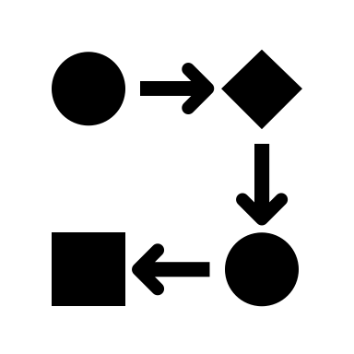



PCTF Verified Person Simulation of Government ID Proofing, Registration, Issuance
https://sandbox.pctf.
Prov1
Prov2
Drivers License or Services Card
Fed
Birth Certificate
Terr1
Terr2

Slide 4
























PCTF Verified Person Simulation of Government ID Proofing, Registration, Issuance
https://sandbox.pctf.
Simulated services for a Canadian Digital Economy, Society, Industry
Prov1
Demonstration of Empowered Canadians
Prov2
Drivers License or Services Card
Fed
Birth Certificate
Personal Agent Apps from App Stores
Terr1
Terr2

Slide 5



















PCTF Verified Person Simulation of Government ID Proofing, Registration, Issuance
https://sandbox.pctf.
Simulated services for a Canadian Digital Economy, Society, Industry
Prov1
Demonstration of Empowered Canadians
Prov2
Drivers License or Services Card
Fed
Birth Certificate
Personal Agent Apps from App Stores
Terr1
Terr2

Slide 6
Demonstration – Proof of Concept
A live demonstration will illustrate the feasibility of this concept
Demonstration will illustrate the potential value and benefit for Canadians that is associated with government issued digital identity: specifically the verified person component of the Pan-Canadian trust framework
Demonstration will illustrate how creating web login services are not the same things as having government’s issue digital identity to Canadians so they may interact, as they choose, across the whole economy and society

Slide 7
Questions and Dialogue
On the assumption that the technical aspects of the idea can be made easy for joint councils members to complete:
Is there enough interest in having the newly established Jurisdictional Experts on Digital Identity (JEDI) sponsor the creation of a functional sandbox environment for the Pan-Canadian Trust Framework in collaboration with DIACC?
Is there enough support for targeting this as a demonstratable deliverable for the in-person Joint councils meeting Fall 2020?

